Slide 1
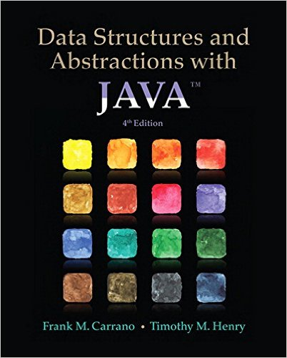
Lecture 4
Chapter 5: Stacks
Chapter 6: Stack Implementations

Slide 2
Contents
Specifications of the ADT Stack
Using a Stack to Process Algebraic Expressions
  A Problem Solved: Checking for Balanced Delimiters in an Infix Algebraic Expression
  A Problem Solved: Transforming an Infix Expression to a Postfix Expression
  A Problem Solved: Evaluating Postfix Expressions
  A Problem Solved: Evaluating Infix Expressions

Slide 3
Contents
The Program Stack
Java Class Library: The Class Stack

Slide 4
Objectives
Describe operations of ADT stack
Use stack to decide whether delimiters in an algebraic expression are paired correctly
Use stack to convert infix expression to postfix expression

Slide 5
Objectives
Use stack to evaluate postfix expression
Use stack to evaluate infix expression
Use a stack in a program
Describe how Java run-time environment uses stack to track execution of methods

Slide 6
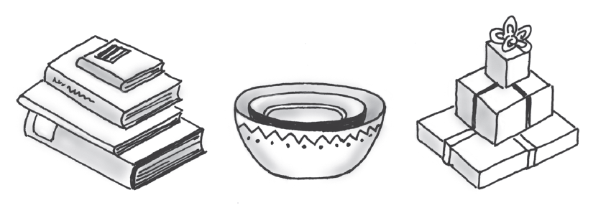
Specifications of a Stack
Organizes entries according to order added
All additions added to one end of stack
  Added to “top”
  Called a “push”
Access to stack restricted
  Access only top entry
  Remove called a “pop”

Slide 7
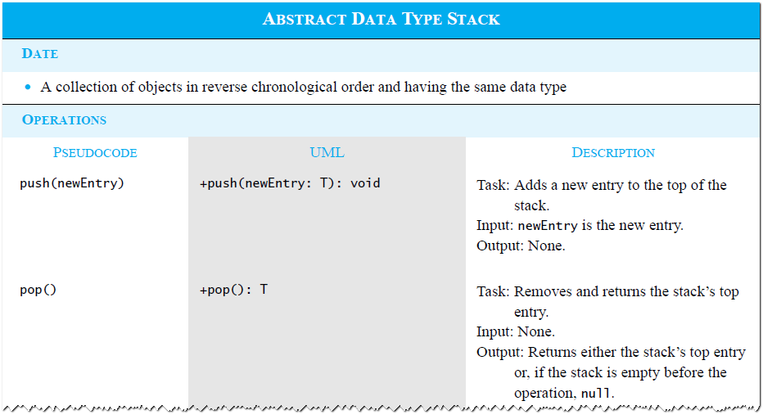
ADT Stack

Slide 8
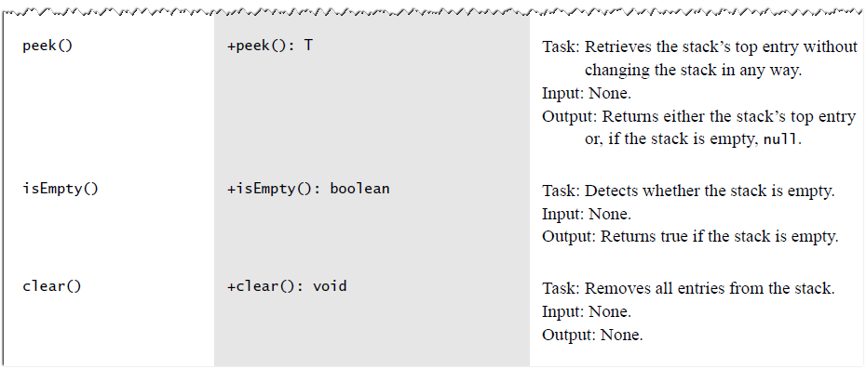
ADT Stack

Slide 9
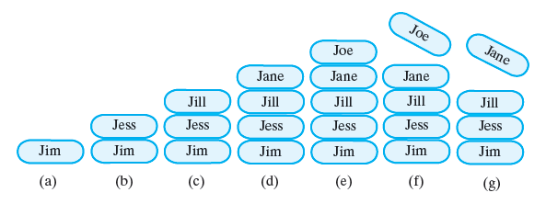
(a) push adds Jim;
(b) push adds Jess;
(c) push adds Jill;
(d) push adds Jane;
(e) push adds Joe;
(f ) pop retrieves and removes Joe;
(g) pop retrieves and removes Jane
Specify Class Stack
Interface
  Note source code (p.157), Listing 5-1

Slide 10
Specify Class Stack
Example usage
Stack<String> stringStack = new Stack<>();
// stack is empty
stringStack.push(“Jim”);
stringStack.push(“Jess”);
stringStack.push(“Jill”);
stringStack.push(“Jane”);
stringStack.push(“Joe”);
// “Joe” is the top of the stack
String top = stringStack.peek(); // returns “Joe”
// “Joe” is the top of the stack
top = stringStack.pop(); // removes “Joe”
// “Jane” is the top of the stack
top = stringStack.peek(); // returns “Jane”
// “Jane” is the top of the stack
top = stringStack.pop(); // removes “Jane”
// “Jill” is the top of the stack

Slide 11
Using a Stack to Process Algebraic Expressions
Algebraic expressions composed of
  Operands (variables, constants)
  Operators (+, -, /, *, %)
Operators can be unary or binary
Different precedence notations
  Infix a + b
  Prefix + a b
  Postfix a b +

Slide 12
Using a Stack to Process Algebraic Expressions
Precedence must be maintained
  Order of operators
  Use of parentheses (must be balanced)
Use stacks to evaluate parentheses usage
  Scan expression
  Push symbols
  Pop symbols

Slide 13
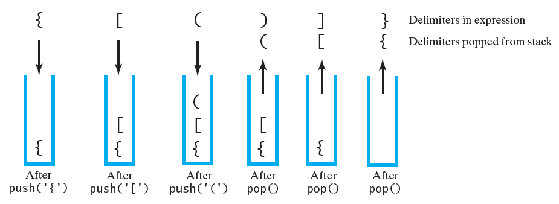
The contents of a stack during the scan of an expression that contains the balanced delimiters { [ ( ) ] }

Slide 14
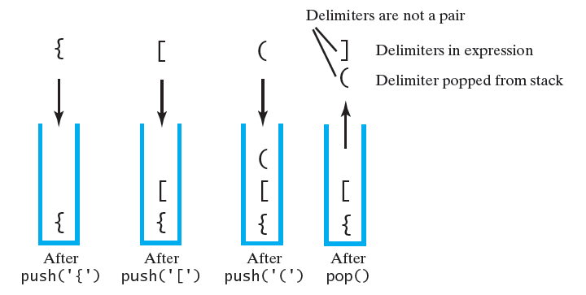
The contents of a stack during the scan of an expression that contains the unbalanced delimiters { [ ( ] ) }

Slide 15
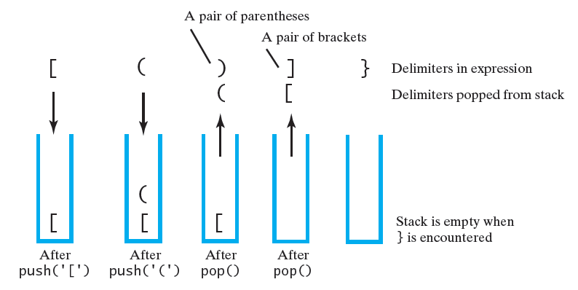
The contents of a stack during the scan of an expression that contains the unbalanced delimiters [ ( ) ] }

Slide 16
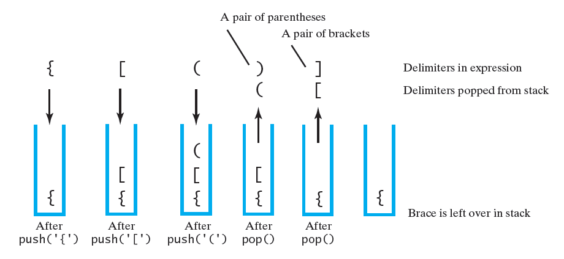
The contents of a stack during the scan of an expression that contains the unbalanced delimiters { [ ( ) ]

Slide 17
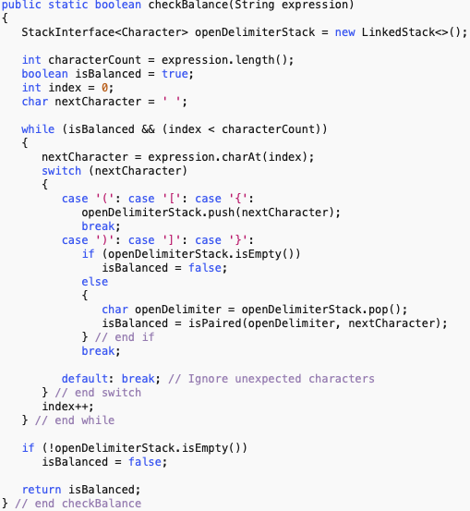

Balance Checker
See segment 5.10
on page 163

Slide 18
Infix to Postfix
Manual algorithm for converting infix to postfix (a + b) * c
  Write with parentheses to force correct operator precedence ((a + b) * c)
  Move operator to right inside parentheses
  ((a b + ) c * )
  Remove parentheses
  a b + c *
This mathematical notation in which every operator follows all of its operands is called Reverse Polish Notation (RPN)

Slide 19
Infix to Postfix Conversion
To convert an infix expression to postfix form, you take the following actions, according to the symbols you encounter, as you process the infix expression from left to right:
Symbol | Action
Operand | Append each operand to the end of the postfix expression as they arrive
Operator + - * / % | If the incoming operator has higher precedence than the top of the stack, push it on the stack If the incoming operator has equal precedence with the top of the top of the stack pop the top of the stack and append it to the postfix expression and then push the incoming operator If the incoming operator has lower precedence than the top of the stack, pop the stack and append it to the postfix expression. Then test the incoming operator against the new top of stack.
Open parenthesis | Push ( onto the stack
Close parenthesis | Pop operators from the stack and append them to the postfix expression until an open parenthesis is popped. Discard both parenthesis
End of expression | Pop and print all operators on the stack

Slide 20
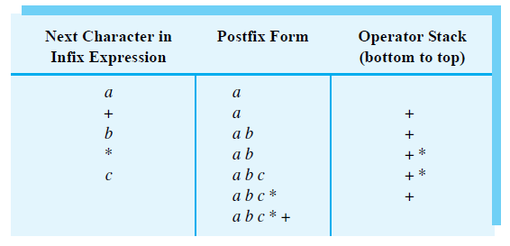
Converting the infix expression a+b*c to postfix form

Slide 21
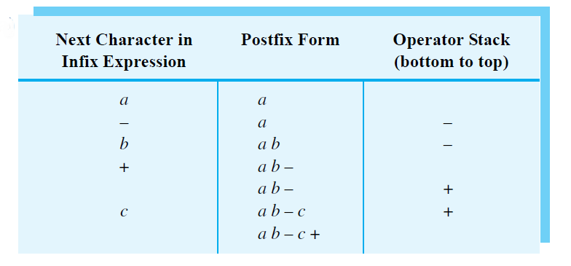
Converting an infix expression to postfix form: a-b+c

Slide 22
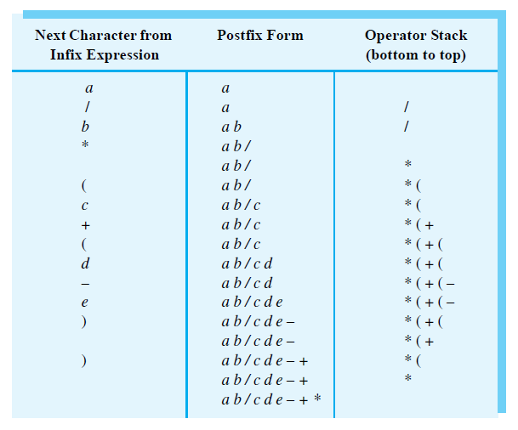
The steps in converting the infix expression a/b*(c+(d-e)) to postfix form

Slide 23
Question
Using the previous algorithm, represent each of the following infix expressions as a postfix expression:
  (a + b) / (c – d)
  a / (b – c) * d
  a – (b / (c – d) * e + f) * g
  (a – b * c) / (d * e * f * g + h)

Slide 24
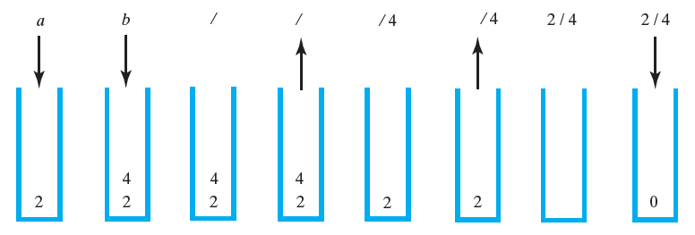
Evaluating Postfix Expressions
The stack during the evaluation of the postfix expression ab/
when a is 2 and b is 4

Slide 25
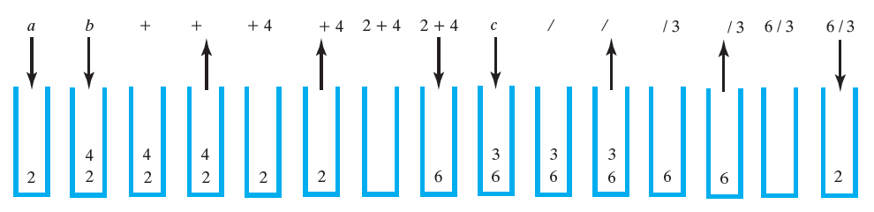
The stack during the evaluation of the postfix expression ab+c/ when a is 2, b is 4, and c is 3

Slide 26
Question
Using the previous algorithm, evaluate each of the following postfix expressions. Assume that a is 2, b is 3, c is 4, d is 5, and e is 6. Next convert the postfix to infix and check the result:
  ae+bd-/
  abc*d*-
  abc-/d*
  ebca**+d-

Slide 27
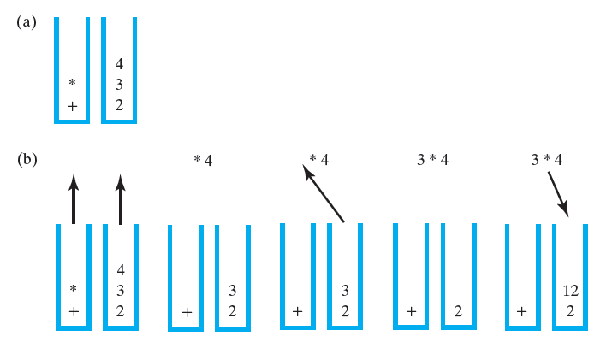
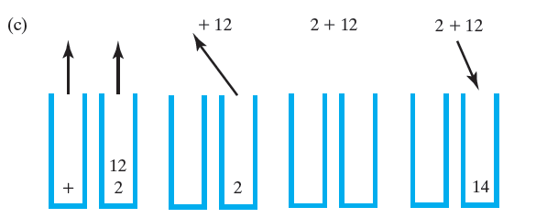
Evaluating Infix Expressions
Two stacks during the evaluation of a+b*c when a is 2, b is 3, and c is 4:
(a) after reaching the end of the expression;
(b) while performing the multiplication;
(c) while performing the addition

Slide 28
The Program Stack
See: JVM Program Stack

Slide 29
Java Class Library: The Class Stack
Has a single constructor
  Creates an empty stack
Remaining methods – differences from our StackInterface are highlighted
  public T push(T item);
  public T pop();
  public T peek();
  public boolean empty();
A more complete and consistent set of LIFO stack operations is provided
by the Deque interface and its implementations, which should be used
in preference to this class. For example:
  Deque<Integer> stack = new ArrayDeque<>();
However, we will use Stack for now and use ArrayDeque later on in
the semester.

Slide 30
Question
You have a stack of cards (original stack) that are unsorted. Your task is to move all the cards from the original stack to another stack (destination stack) so that they are sorted with the largest card at the bottom and the smallest card at the top.
At any given time the cards on the destination stack must be sorted.
Cards cannot be added to the original stack, utilize a third stack (temporary stack) to help you with this process.

Slide 31
Stack Implementations

Slide 32
Contents
A Linked Implementation
An Array-Based Implementation

Slide 33
Objectives
Implement ADT stack by using either
  Linked chain
  Array
Compare and contrast various implementations and their performance

Slide 34
Linked Implementation
Consider push, pop, peek
  Each involves top of stack
Best to put top of stack at head node
  Fastest, easiest to access
Java will manage reclaiming memory without instruction from programmer

Slide 35
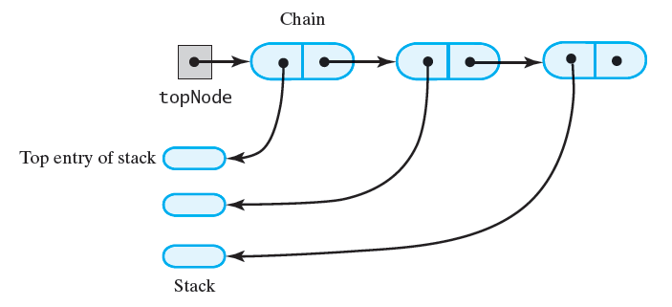
LInkedStack class
public final class LinkedStack<T> implements
TextbookStackInterface<T>
{
private Node<T> topNode; // References the first node
// in the chain
public LinkedStack()
{
this.topNode = null;
} // end default constructor
…
}

Slide 36
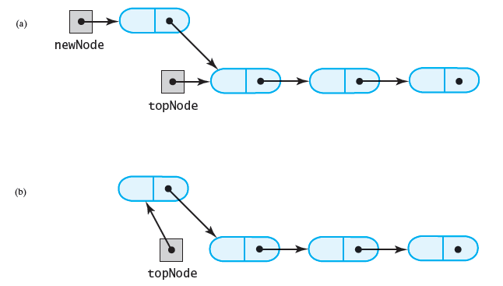
Linked Implementation - push
public void push(T newEntry)
{
this.topNode = new Node(newEntry, this.topNode);
} // end push

Slide 37
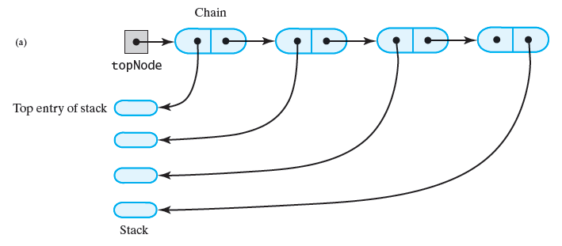
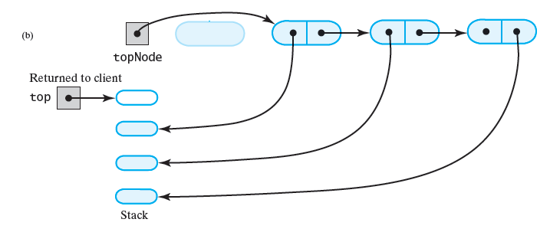
Linked Implementation - pop
public T pop() throws InsufficientNumberOfElementsOnStackException
{
if (this.topNode == null)
throw new InsufficientNumberOfElementsOnStackException(
"cannot complete pop() - stack is empty");
T top = this.topNode.data;
this.topNode = this.topNode.next;
return top;
} // end pop

Slide 38
Linked Implementation - peek
public T peek() throws InsufficientNumberOfElementsOnStackException
{
if (this.topNode == null)
throw new InsufficientNumberOfElementsOnStackException(
"cannot complete peek() - stack is empty");
return this.topNode.data;
} // end pop

Slide 39
Array Based Implementation
Again the question:
  Were to place the top entry?
More efficient operations with bottom of stack at beginning of array
  Top of stack at last occupied entry
Must consider memory wastage of unused array elements

Slide 40
ArrayStack class
public class ArrayStack<T> implements StackInterface<T>{
private T[] stack; // Array of stack entries
private int topIndex; // Index of top entry
private boolean initialized = false;
private static final int DEFAULT_CAPACITY = 50;
private static final int MAX_CAPACITY = 10000;
public ArrayStack(){
this(DEFAULT_CAPACITY);
} // end default constructor
public ArrayStack(int initialCapacity){
checkCapacity(initialCapacity);
T[] tempStack = (T[])new Object[initialCapacity];
this.stack = tempStack;
this.topIndex = -1;
initialized = true;
} // end constructor
…
}

Slide 41
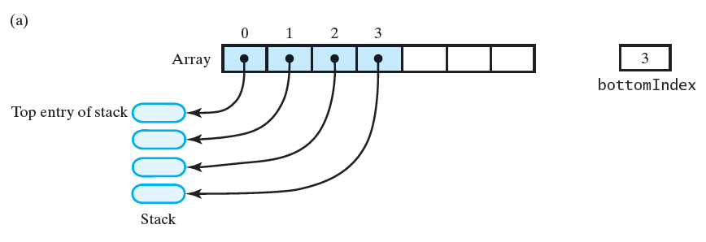
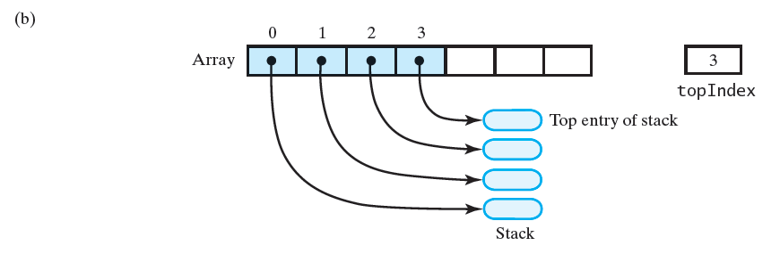
An array that implements a stack: its first location references (a) the top entry in the stack; (b) the bottom entry in the stack;

Slide 42
Adding to the Top - push
public T push()
{
checkInitialization();
ensureCapacity();
this.topIndex++;
this.myStack[this.topIndex] = newEntry;
} // end push
private void ensureCapacity()
{
if (this.topIndex == this.stack.length – 1)
this.myStack = Arrays.copyOf(this.stack,
2 * this.stack.length);
} // end ensureCapacity

Slide 43
Retrieving the Top - peek
public T peek() throws InsufficientNumberOfElementsOnStackException
{
checkInitialization();
if (isEmpty())
throw new InsufficientNumberOfElementsOnStackException(
"peek operation failed");
return this.myStack[this.topIndex];
} // end pop

Slide 44
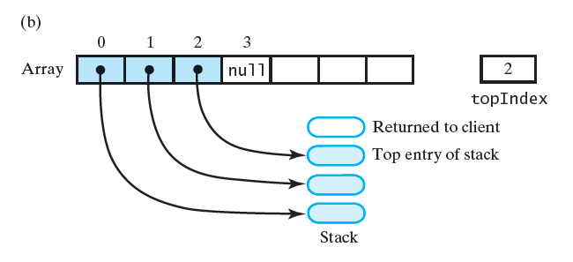
Removing the Top - pop

Slide 45
Removing the Top - pop
public T pop() throws InsufficientNumberOfElementsOnStackException
{
checkInitialization();
if (isEmpty())
throw new InsufficientNumberOfElementsOnStackException(
"pop operation failed");
T top = this.myStack[this.topIndex];
this.myStack[this.topIndex] = null;
this.topIndex--;
return top;
} // end pop

